Slide 1
Lesson 6
Joins

Slide 2
Joining Related Tables
With normalized databases, information required for a single result set may be located in more than one table
When defining a JOIN, you must:
Define the tables to be joined
Define the join type
Define a join condition, which is made up of the columns on which the tables are joined and the logical operator

Slide 3
INNER JOIN
INNER JOINs allow you to match related records from different tables
Return only the rows from tables that match the join condition
INNER keyword is optional

Slide 4
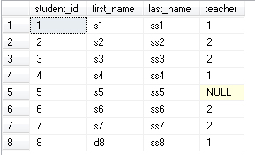

Student
Teacher

Slide 5
To generate a class list showing each
student’s name and their teacher
SELECT student.first_name,
student.last_name,
teacher.first_name,
teacher.last_name
FROM
student
INNER JOIN
teacher
ON
student.teacher = teacher.teacher_id

Slide 6
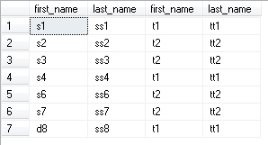
Student 5 and Teacher 3 are missing!!!

Slide 7
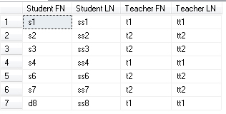
Same example using alias
SELECT
s.first_name AS 'Student FN', s.last_name AS 'Student LN', t.first_name AS 'Teacher FN', t.last_name AS 'Teacher LN'
FROM
student AS s
INNER JOIN
teacher AS t
ON
s.teacher = t.teacher_id

Slide 8
LEFT and RIGHT OUTER JOIN
OUTER JOIN also include records from one or both tables that do not have corresponding record(s) in the other table
Returns all rows from one table (Left or Right) and only information from rows that are in common from other table
OUTER keyword is optional

Slide 9
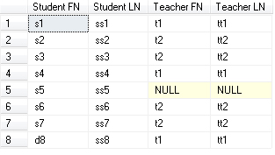
SELECT s.first_name AS 'Student FN', s.last_name AS 'Student LN', t.first_name AS 'Teacher FN', t.last_name AS 'Teacher LN'
FROM
student AS s
LEFT OUTER JOIN
teacher AS t
ON s.teacher = t.teacher_id

Slide 10
Right outer join
This example and previous one are the same
SELECT
s.first_name AS 'Student FN', s.last_name AS 'Student LN', t.first_name AS 'Teacher FN', t.last_name AS 'Teacher LN'
FROM
teacher AS t
Right OUTER JOIN
student AS s
ON
s.teacher = t.teacher_id
Tables swapped

Slide 11
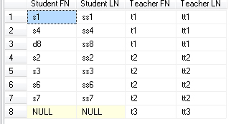
SELECT s.first_name AS 'Student FN', s.last_name AS 'Student LN',
t.first_name AS 'Teacher FN',
t.last_name AS 'Teacher LN'
FROM student AS s
RIGHT OUTER JOIN teacher AS t
ON s.teacher = t.teacher_id

Slide 12
FULL OUTER JOIN
The FULL OUTER JOIN is a combination of the LEFT JOIN and the RIGHT JOIN
A FULL OUTER JOIN displays every row from every table in the JOIN clause
This can be helpful in finding unmatched rows when relational integrity is not being enforced on the tables.

Slide 13
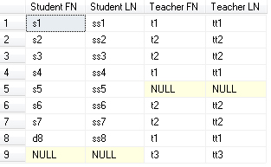
SELECT s.first_name AS 'Student FN', s.last_name AS 'Student LN', t.first_name AS 'Teacher FN',
t.last_name AS 'Teacher LN'
FROM student AS s
FULL OUTER JOIN teacher AS t
ON s.teacher = t.teacher_id

Slide 14
Cross JOIN
Cross joins provide a Cartesian product of the two tables. Every row from the first table is joined with every row from the second table
This JOIN does not have a ON clause

Slide 15
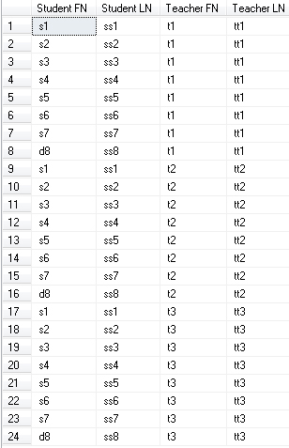
SELECT s.first_name, s.last_name, t.first_name, t.last_name
FROM student AS s
CROSS JOIN
teacher AS t

Slide 16
To use the Nums table in TSQL2012 DB to generate a result with a row for each weekday (1 through 7) and shift number (1 through 3), assuming there are three shifts a day.
SELECT D.n AS theday, S.n AS shiftno
FROM dbo.Nums AS D
CROSS JOIN
dbo.Nums AS S
WHERE
D.n <= 7 AND S.n <= 3
ORDER BY theday, shiftno;

Slide 17
Joining a table with itself
This situation is known as a SELF-JOIN, and it occurs when you want to compare records in a table to each other
Typical example of a self-join is a “flattened” employees table that contains information on an organizational hierarchy

Slide 18
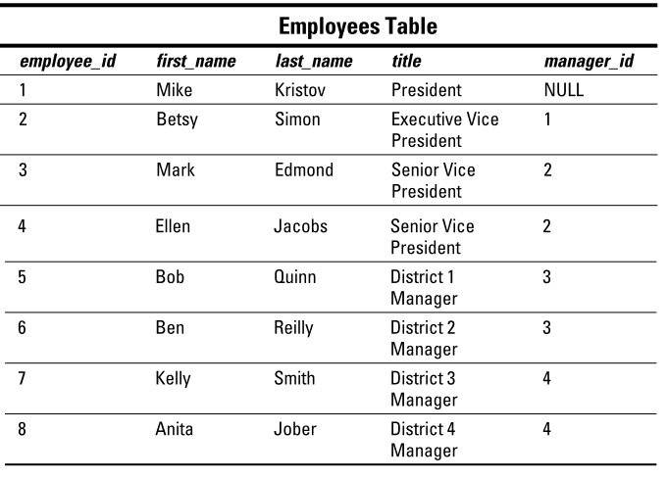
Internal reference

Slide 19
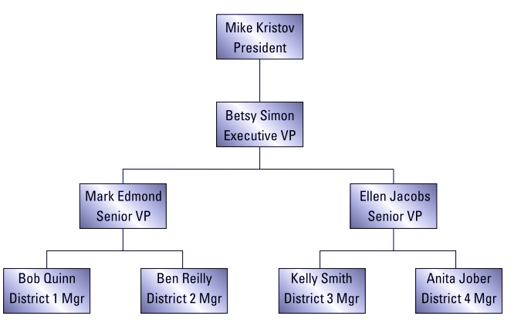
Representation of previous table

Slide 20
SELECT e.first_name AS ‘Employee FN’,
e.last_name AS ‘Employee LN’,
e.title AS ‘Employee Title’,
m.first_name AS ‘Manager FN’, m.last_name AS ‘Manager LN’
FROM
employees AS e
LEFT OUTER JOIN
employees AS m
ON e.manager_id = m.employee_id

Slide 21
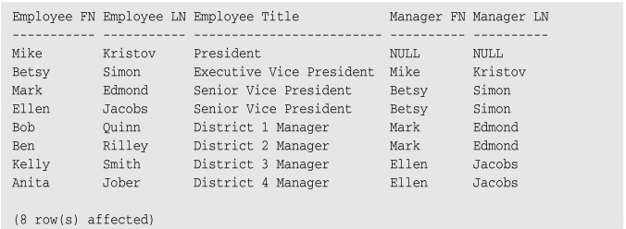
If we used an INNER JOIN instead of a LEFT OUTER JOIN, my employee list would have omitted the company’s president, who
has no manager

Slide 22
Combining Datasets
The UNION, EXCEPT and INTERSECT operators can be specified between two or more queries to provide a single result set
EXCEPT and INTERSECT operators compare the result sets of two queries to determine what subset of rows should be included in the final result set

Slide 23
UNION Operator
The UNION operator allows you to combine the result sets created by multiple SELECT statements into a single result set
The ALL keyword specifies that all rows, including duplicate rows, should be returned
By default, duplicate rows are not returned

Slide 24
When specifying the UNION operator, both queries must return the same number of columns
Each data type in the corresponding columns must be compatible
SELECT
CONVERT (Char(8), Employees.EmployeeID)
FROM Employees
UNION
SELECT Customers.CustomerID FROM Customers
String

Slide 25
The column titles are taken from the first query listed
ORDER BY clauses should be defined at the end of the last SELECT statement
Each SELECT statement should include its own WHERE clause

Slide 26
use Northwind
SELECT FirstName+' '+LastName AS 'Contact Name',
[Northwind Traders] AS 'Company',
Employees.HomePhone AS 'Phone'
FROM Employees
UNION
SELECT
ContactName, CompanyName, Phone
FROM Customers
ORDER BY [Contact Name];

Slide 27
EXCEPT and INTERSECT
The EXCEPT operator returns all rows that exist in the table to the left of the operator that do not have matching rows in the table to the right
SELECT EmployeeKey
FROM DimEmployee
EXCEPT
SELECT EmployeeKey
FROM FactResellerSales
Employees who have never placed a reseller sales order

Slide 28
The same number of columns with compatible data types must be defined in both queries
You may need to join the tables to achieve this
USE JOB_PORTAL_DB;
GO
SELECT SL.Login, SL.Full_Name
FROM [dbo].[Security_Logins] AS SL
EXCEPT
SELECT SL.Login, SL.Full_Name
FROM [dbo].[Security_Logins] AS SL
INNER JOIN
[dbo].[Security_Logins_Log] AS SLL
ON SLL.Login = SL.Id;
Find users who have never logon to the system

Slide 29
INTERSECT returns matching rows from both queries only.
Find users who applied for a job in year of 2017
USE JOB_PORTAL_DB;
GO
SELECT SL.Login, SL.Full_Name
FROM [dbo].[Security_Logins] AS SL
INTERSECT
SELECT SL.Login, SL.Full_Name
FROM [dbo].[Security_Logins] AS SL
INNER JOIN [dbo].[Applicant_Profiles] AS AP ON AP.Login = SL.Id
INNER JOIN [dbo].[Applicant_Job_Applications] AS AJA ON AJA.Applicant = AP.Id
WHERE AJA.Application_Date BETWEEN '2017-01-01' AND '2017-12-31'

